Slide 1
Herne View Church of England Primary School
Year 3 & Year 4
Knowledge Organisers
Autumn A 2023

Slide 2
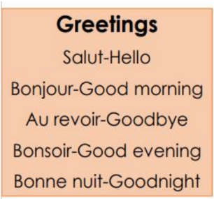
French – Can you greet others and name some colours?
Bleu – blue
Noir – black
Rouge – red
Blanc - white

Slide 4
